Slide 1



AMAZON
SALES ANALYSIS
SHAIK KHWAJA MOHIDDIN
Batch-Oct 2023
Newton school

Slide 2

01 - Introduction
02 - Problem statement
03 - Data cleaning
04 – Insights & KPI’s
05 - Dashboard
06 - Conclusions

Slide 3
01 - Introduction
Amazon is one of the world's largest multinational technology companies, specializing in e-commerce .Founded by Jeff Bezos in 1994, Amazon started as an online bookstore but rapidly expanded its offerings to include a wide range of products and services.
E-commerce: Amazon's primary business is its online marketplace, where consumers can purchase a vast array of goods, including books, electronics, clothing, and household items. The company offers various delivery options, including Prime, which provides subscribers with fast and often free shipping and we are going to view the sales performance and making dashboard report using PowerBI Business intelligence tool.

Slide 4
02 - PROBLEM STATEMENT
In the ever-changing world of e-commerce, Amazon's ongoing mission is to identify, reward, and enhance its consumers' shopping experiences. Even with the present strategies, such as sales and Prime membership perks, fresh approaches are still needed to engage customers and create ongoing loyalty in order to develop comprehensive programs that leverage data-driven insights and enhance the entire Amazon shopping experience.

Slide 5

03 - Data Cleaning
I used the power query editor to clean and standardize the provided data. Possibilities include eliminating duplicates in the order id, changing the data type, replacing a few null values, and removing excess empty columns.

Slide 6
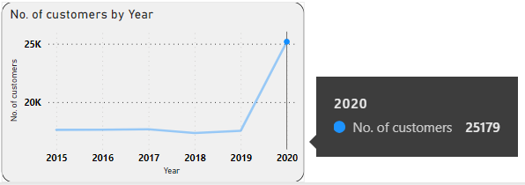
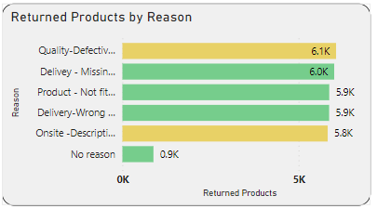
04 –Insights & KPI’s
Customers from the year 2020 have increased in number of customers which was ‘25179’ when compared to the previous year 2019 which was ‘17537’.
“Electronics” of Product category, Digital camera of Sub-category, “Canon EOS 18MP CMOS DSLR Camera-black” of Product are most popular.
Decrease in sales in the year-2018 compared to 2017 sales and Increase in sales in the year-2020 when compared to previous year-2019.
From the overall 31k returned products the most possible reasons for returned products is due to Defective items were delivered.

Slide 7
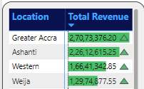
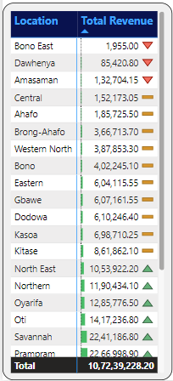
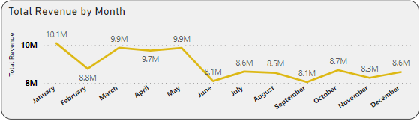
Areas like Greater Accra, Ashanti, western and Weija are places with Highest Revenue is generated.
The success of marketing initiatives can be increased by enhancing marketing techniques such utilizing local language, images, cultural references, and promotional offers that connect with the community in areas like Bono East, Dawhenya, Amasaman.
January month has its high revenue most likely due to festival season and better campaigns And in the month of June and September has lesser revenue generated compared to other months.

Slide 8
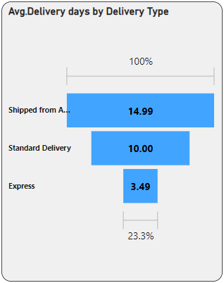
Even with their expensive items, such as the Samsung Galaxy A02-64GB HDD-3GB RAM Smartphone-Black,32GB HDD-2GB RAM-8 Blue Amazon Fire HD 8 kids tablet are Under preformed and this product needs additional marketing efforts and Promotional offers to improve the sales.
The product category and delivery type have a correlation with the average time for different product categories. The standard delivery wait time corresponds to the second delivery week.
A product's typical delivery time depends on the method of delivery; the fastest delivery type-Express delivery takes 3.4 days on average.
The product dispatched from overseas has an average delivery time of 14.99 days, compared to 10 days for regular shipping.
The average of shipping fee for all the product types are almost similar.

Slide 9
Suggestions to improve sales
Festival-themed Campaigns: Create marketing campaigns that resonate with the spirit of specific festivals, incorporating relevant imagery, colors, and messaging.
Regional Targeting: Tailor promotions to specific regions in India where certain festivals or cultural events hold greater significance, ensuring relevance to local customs and traditions.
Mobile Marketing: Utilize mobile marketing channels such as SMS marketing, mobile apps, and push notifications to reach consumers directly on their smartphones, especially in a mobile-first market like India.
Cashback and Wallet Offers: Partner with digital payment platforms and offer cashback or discounts for transactions made through their services, encouraging online purchases and driving customer engagement.
Influencer Collaborations: Partner with influencers or celebrities popular in India to promote your products through social media platforms and reach a larger audience.
Localized Advertising: Create ads in regional languages and dialects to connect with consumers in different parts of India, recognizing the diversity of language and culture across the country.

Slide 10
Suggestions to improve sales
Improve inventory management:
Ensure that popular items are adequately stocked to reduce waiting times.
Shipping Type:
Offer free shipping: Consider absorbing shipping costs into the product price or offering free shipping for orders above a certain threshold.
Price optimization:
Bundle discounts: Encourage customers to purchase multiple items by offering discounts for bundle purchases, which can increase the perceived value of the products.
Act on feedback:
Use the insights gained from customer feedback to identify areas for improvement and make necessary adjustments to enhance.
Ensure product quality: Conduct regular quality checks to maintain high standards for your products, reducing the negative reviews due to defective items.
Improve packaging: Invest in sturdy packaging materials to protect products during transit and minimize the risk of damage or breakage.

Slide 11
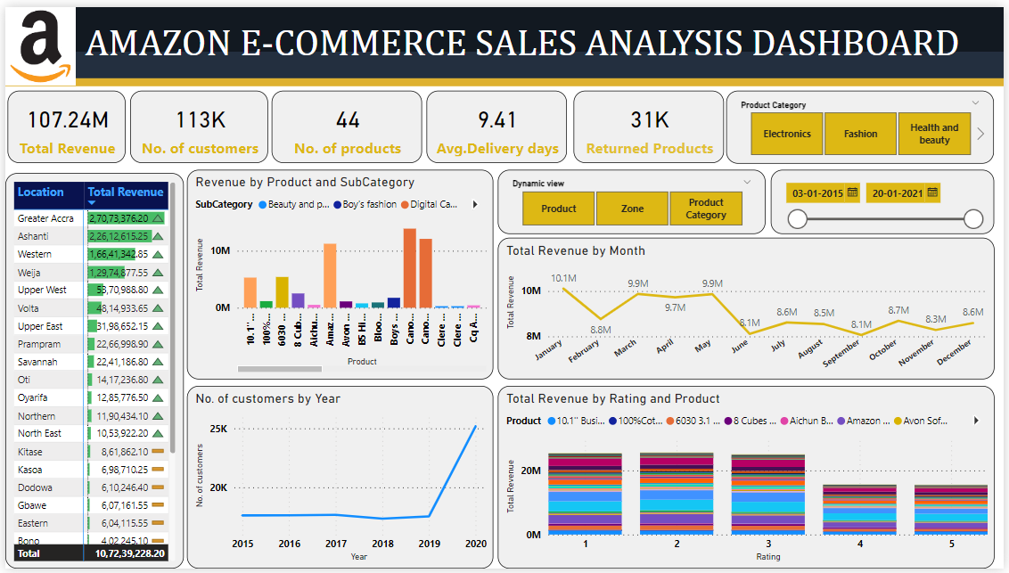
05-DASHBOARD - OVERVIEW

Slide 12
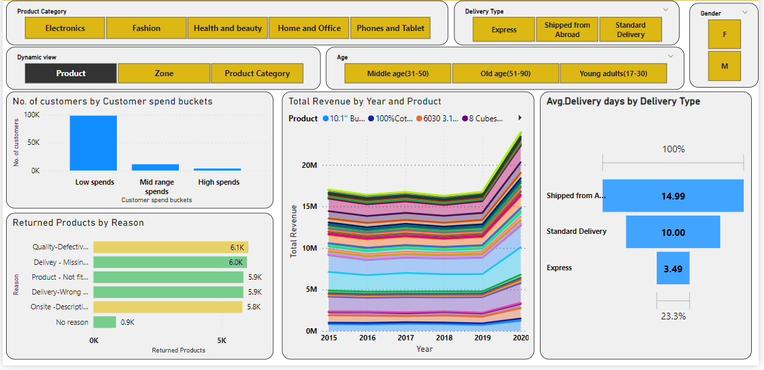
PRODUCT OVERVIEW

Slide 13
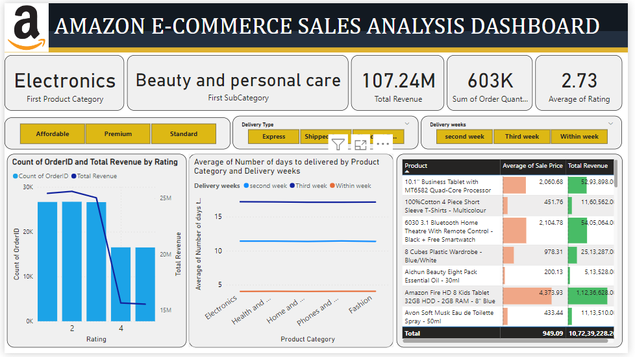
INDIVIDUAL PRODUCT VIEW

Slide 14
06 - Conclusions
In conclusion, the analysis of Amazon's e-commerce data offers valuable insights into customer behavior, product popularity, sales trends, and delivery dynamics.
As Amazon continues its mission to elevate the shopping experience for its customers and to employ fresh strategies that resonate with its audience, such as personalized marketing initiatives tailored to specific regions and demographics.
Moreover, addressing common issues like product defects and optimizing delivery times can further enhance customer satisfaction and loyalty.
By leveraging data-driven insights and embracing new approaches, Amazon can reinforce its position as a leader in e-commerce while continuously refining and enriching the shopping journey for its millions of users worldwide.
personalized marketing initiatives tailored to specific regions and demographics. Moreover, addressing common issues like product defects and optimizing delivery times can further enhance customer satisfaction and loyalty.

Slide 15

Thanks
Are There Any Questions?
Reach me out at khwajamohiddin1999@gmail.com

